Slide 1

CS2009 Design and Analysis of Algorithms
Spanning Trees

Slide 2
Graphs – Minimum spanning tree (MST)
A minimum spanning tree (MST) or minimum weight spanning tree is a subset of the edges of a connected, edge-weighted undirected graph that connects all the vertices together, without any cycles and with the minimum possible total edge weight/costs.
https://www.educative.io/courses/competitive-programming-intvw/Bnyrkq3lR8N

Slide 3
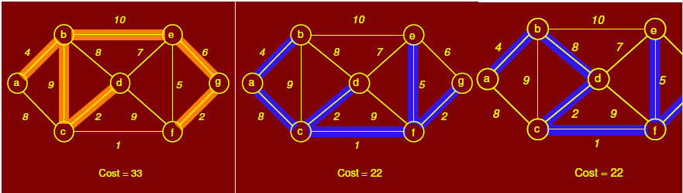
Graphs – Minimum spanning tree (MST)
Below figure shows three spanning trees for same graph. First is a spanning tree but not MST while other two are MST.

Slide 4
Graphs – Minimum spanning tree (MST)
There are two greedy algorithms (greedy in a sense that both chooses the best edge i-e having minimum cost) for finding minimum spanning tree
1) kruskal algorithm (time complexity = theta(ElogV) )
https://www.educative.io/courses/competitive-programming-intvw/xlB6Y594rAE
2) Prims Algorithm (time complexity = theta(ElogV) )
https://www.educative.io/courses/competitive-programming-intvw/BnGJ2lBrqNW
Where E is set of edges and V is set of vertices
Applications of Minimum Spanning Tree :
Laying cables
Laying pipes network or phone network
Tour Operations and many more

Slide 5
Graphs – Kruskal Algorithm for MST
Kruskal algorithm Steps for finding MST :
First select minimum cost edge.
Now select next minimum edge such that it does not form a cycle after addition and repeat this process.
At the end, you will get minimum spanning tree. Sum the cost of all edges and that will be the minimum spanning tree cost.

Slide 6
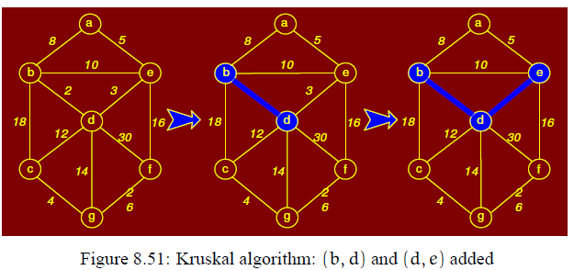
Graphs – Kruskal example

Slide 7
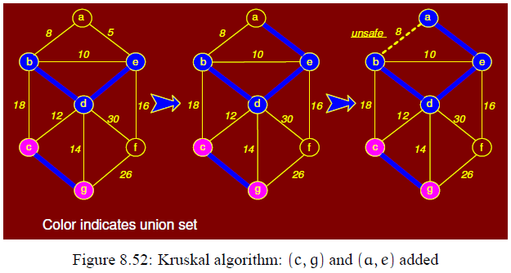
Graphs – Kruskal example

Slide 8
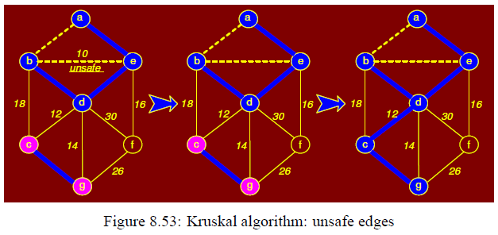
Graphs – Kruskal example

Slide 9
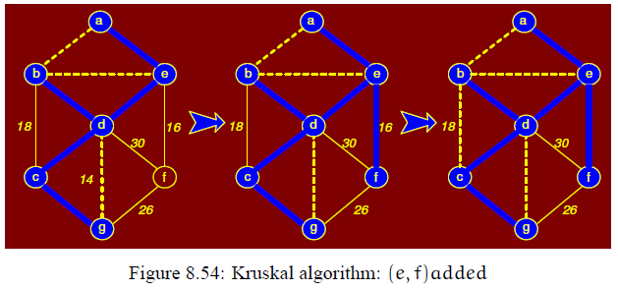
Graphs – Kruskal example

Slide 10
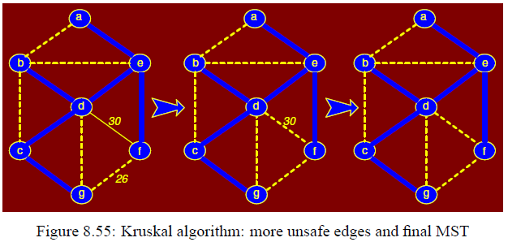
Graphs – Kruskal example
Graph at the end (most right side) is minimum spanning tree.

Slide 11
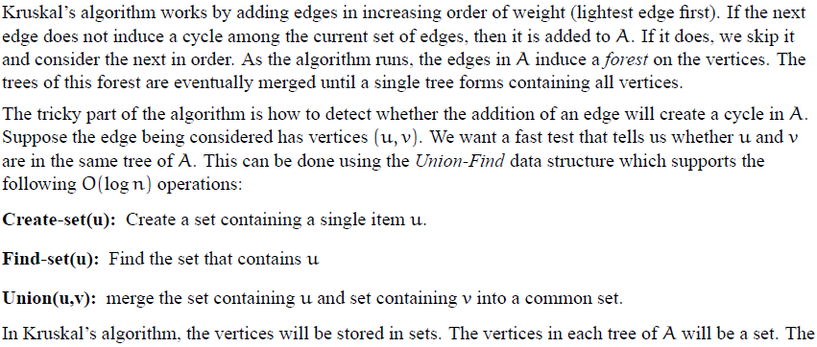
Graphs – Internal Working of Kruskal

Slide 12
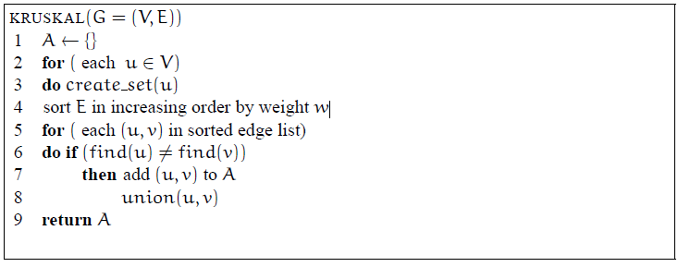
Graphs – Internal Working of Kruskal
Or you can write theta(ElogE) to theta(ElogV) as number of nodes and vertices are almost equal

Slide 13
Graphs – Prims algorithm for MST
Prims algorithm Steps for finding MST :
Randomly select first vertex
Now check all the edges adjacent/connected to first selected vertex and update weights of connected vertices.
Select that edge which has minimum cost among all connected edges.
Now this selected edge has two vertices. Check all the edges connected to these two vertices and select minimum.
Then it will have three vertices. Select minimum edge among edges connected to these three vertices and so on
At the end, you will get minimum spanning tree. Sum the cost of all edges that will be the minimum spanning tree cost.

Slide 14
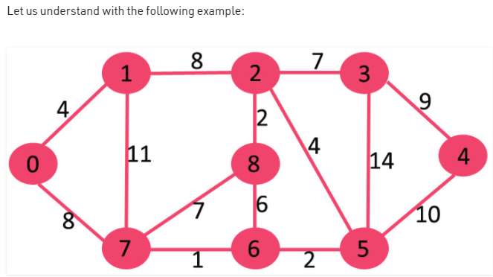
Graphs – Prims Example

Slide 15
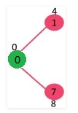
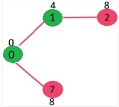
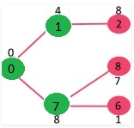
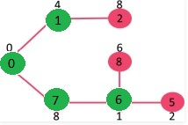
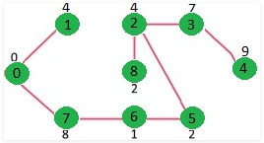
Graphs – Prims Example
This process goes on and at the end you get below minimum spanning tree :

Slide 16
Graphs : Prims algorithm Example 2
Now another Example of prims algorithm in next slide that will show you how prims work actually using minimum priority queue

Slide 17
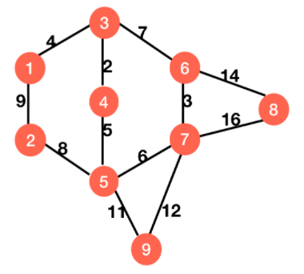
Graphs – Prims Example 2 (Internal working in detail )
We will see complete working of prims in detail (with minimum priority queue) through another example given below

Slide 18
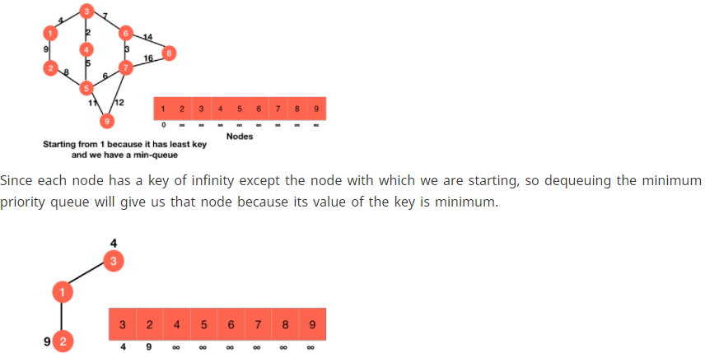
Graphs – Prims Example 2 (Internal working in detail)

Slide 19
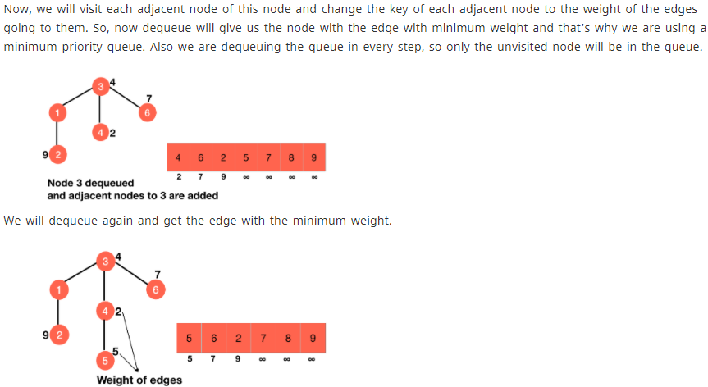
Graphs – Prims Example 2 (Internal working in detail)

Slide 20
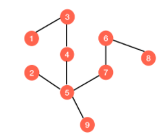
Graphs – Prims Example 2 (Internal working in detail)
And this goes on and on till you get this minimum spanning tree after traversing through all the vertices of priority queue :

Slide 21
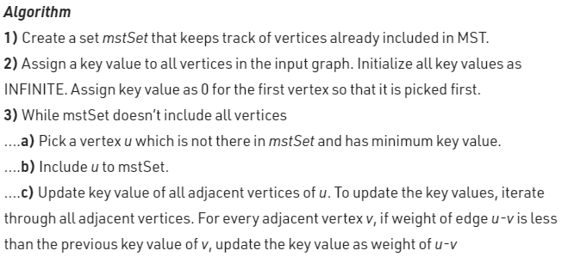
Graphs – Prims algorithm pseudo code
Correction* : In above prims algorithm, u-v in second last line stands for “u to v edge” and not “u minus v”

Slide 22
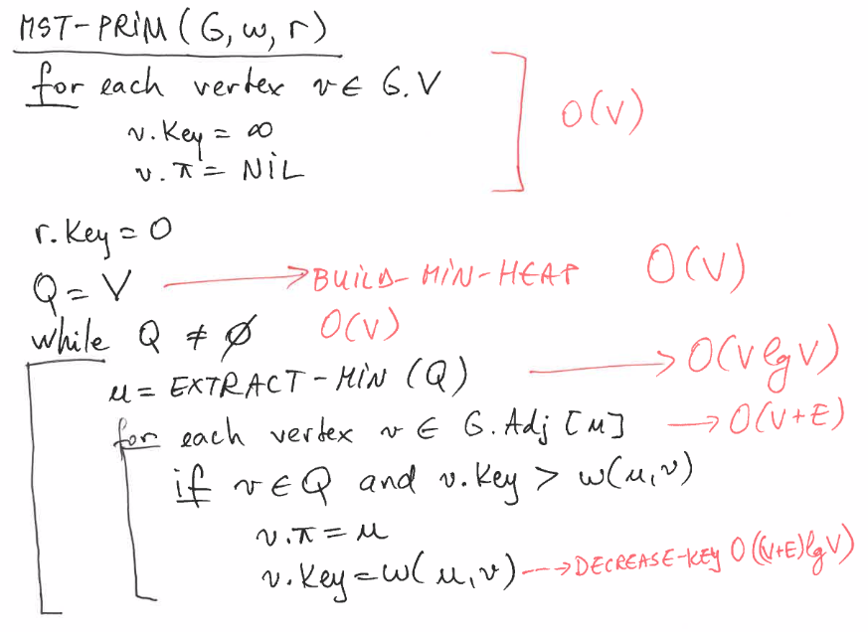
Graphs – Prims algorithm pseudo code
The time complexity is O(VlogV + ElogV) = O(ElogV), making it the same as Kruskal's algorithm.

Slide 23
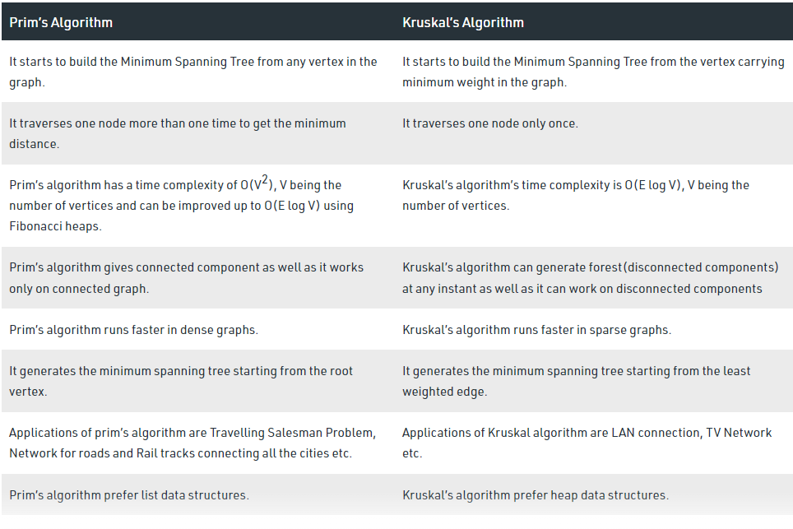
Kruskal & Prims – Greedy algorithms

